Slide 1
Support Vector Machines (SVM)
Part 2
http://www.machinelab.org

Slide 2
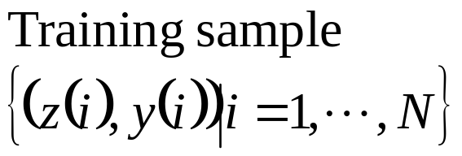
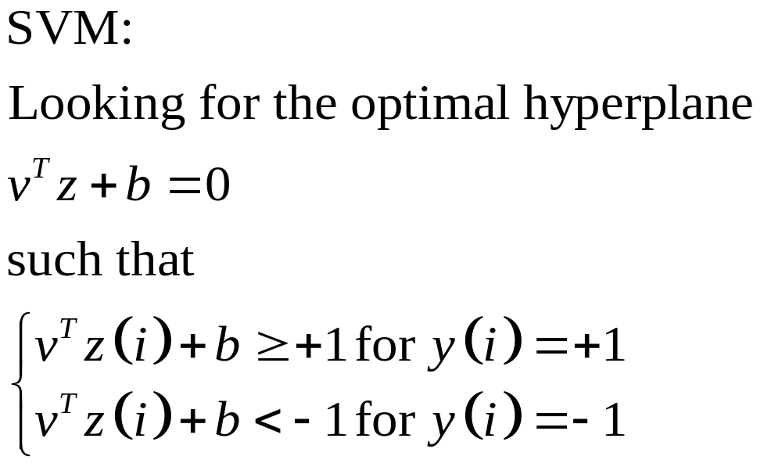


SVM Model

Slide 3
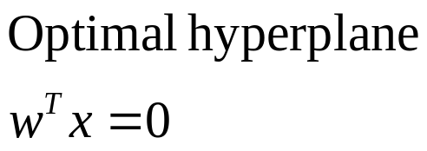




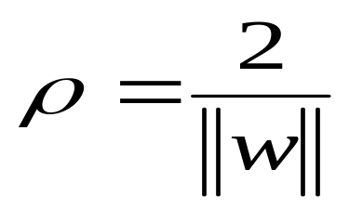
SVM Model

Slide 4
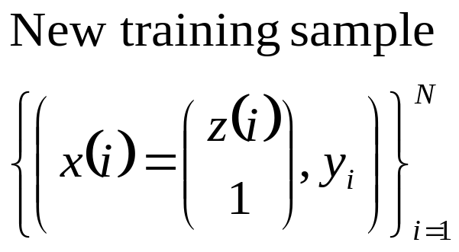
Approximately Linearly Separable

Slide 5
Approximately Linearly Separable

Slide 6
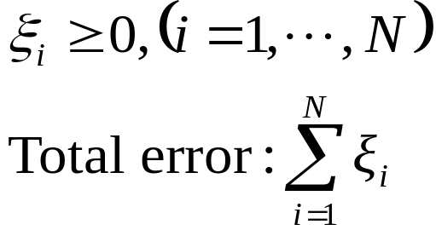

Approximately Linearly Separable

Slide 7
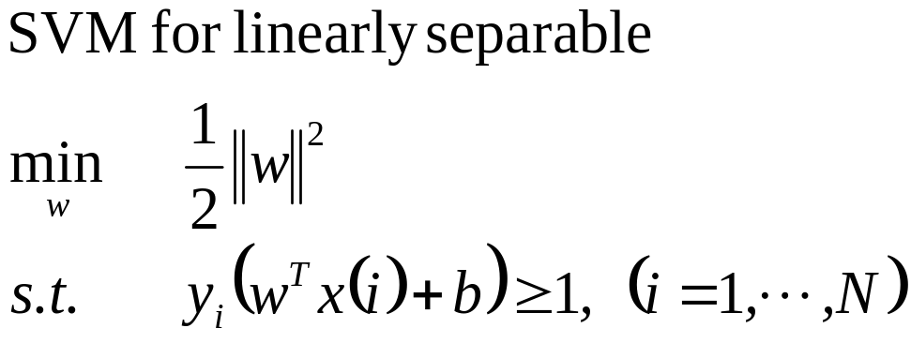

Approximately Linearly Separable
+

Slide 8
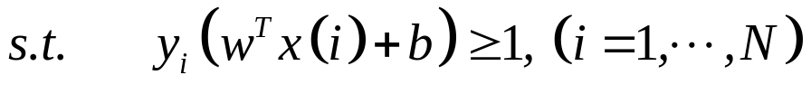
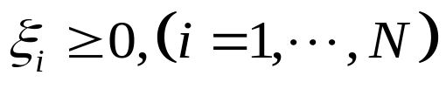
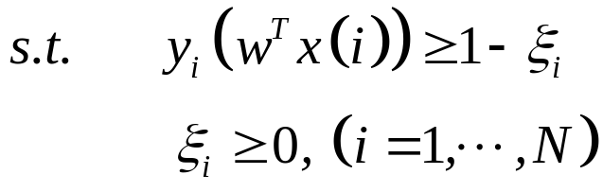

Slide 9
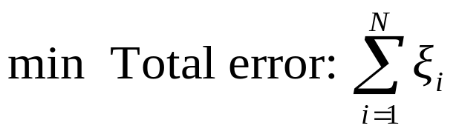
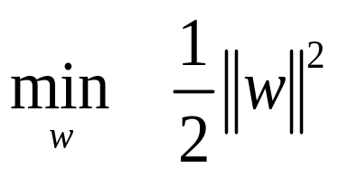

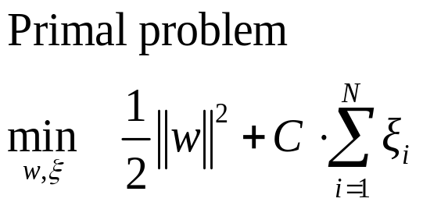

Slide 10

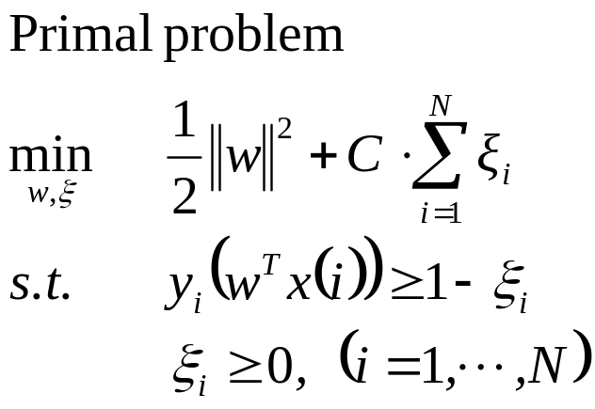
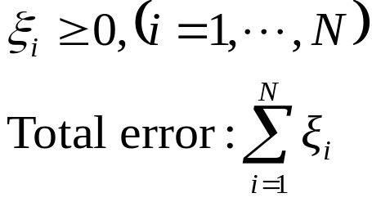
Approximately Linearly Separable
+

Slide 11
Approximately Linearly Separable

Slide 12
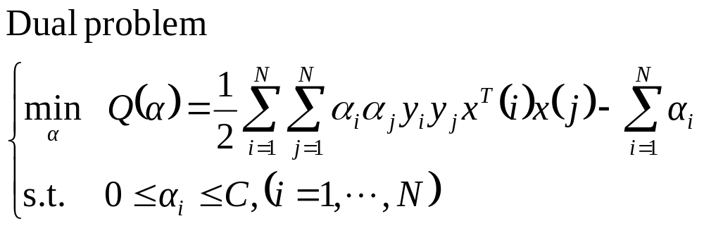
Approximately Linearly Separable

Slide 13
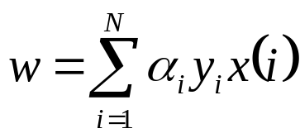

Approximately Linearly Separable

Slide 14
SVM Models
Non-linear SVM

Slide 15
Non-linear SVM
0
x
0
x

Slide 16
Non-linear SVM
0
x
x²
0
x

Slide 17



Non-linear SVM

Slide 18

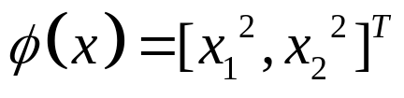
Non-linear SVM

Slide 19



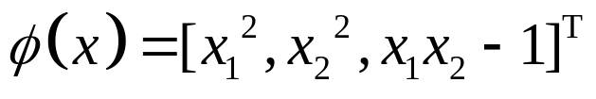

Non-linear SVM

Slide 20


Non-linear SVM

Slide 21




Non-linear SVM
Input Data Space
Feature Space

Slide 22
Non-linear SVM
Nonlinearly separable
linearly separable
Feature Space

Slide 23


Cover’s Theorem
Input Data Space
Feature Space
Cover’s Theorem: Using a transformation to transform patterns in lower-dimensional input data space to higher-dimensional space. Patterns are linearly separable in feature space with high probability, if
  the transformation is nonlinear.
  the dimension of the feature space is high enough.

Slide 24
Cover’s Theorem
A complex pattern-classification problem, cast in a high-dimensional space nonlinearly, is more likely to be linearly separable than in a low-dimensional space, provided that the space is not densely populated.
----Cover, T. M. Geometrical and Statistical properties of systems of linear inequalities with application in pattern recognition. 1965

Slide 25
Mapping to NNs

Slide 26
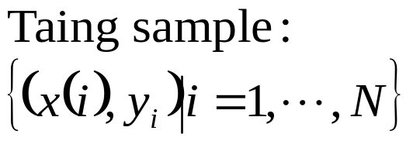
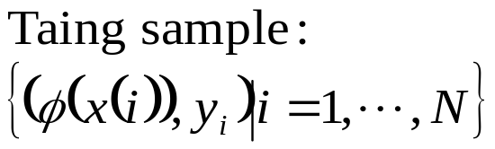
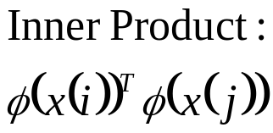
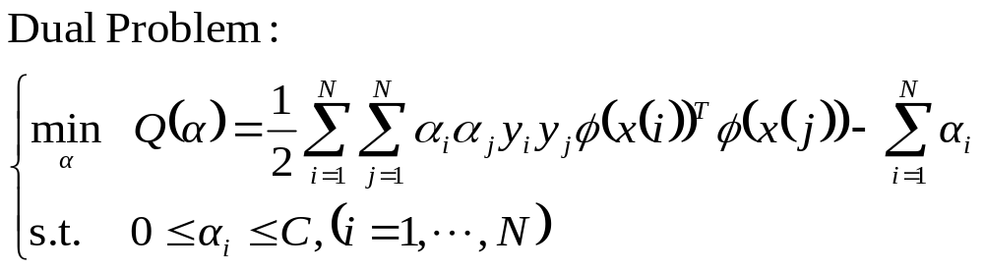
Non-linear SVM

Slide 27
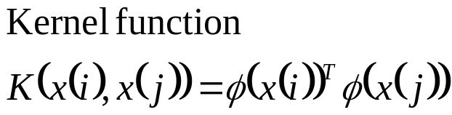
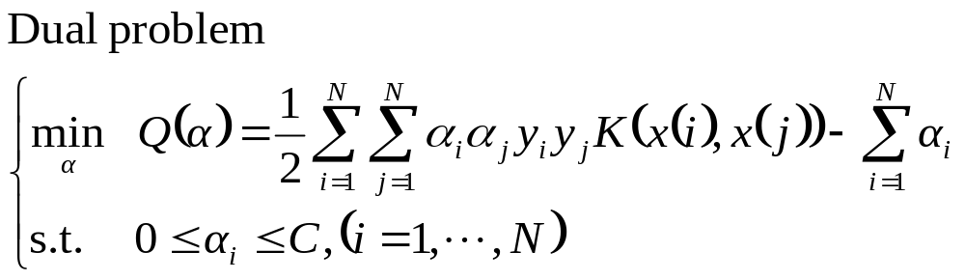
Non-linear SVM

Slide 28
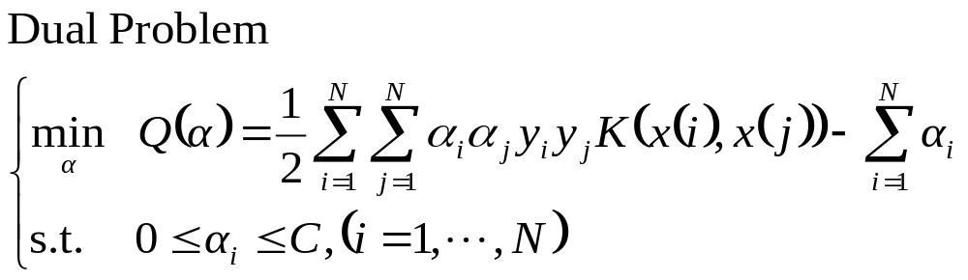
Non-linear SVM

Slide 29
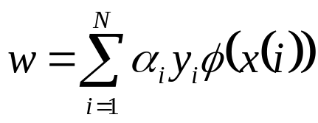
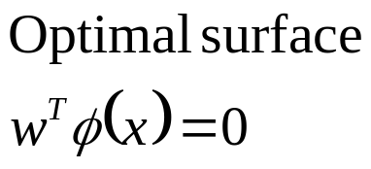
Non-linear SVM

Slide 30
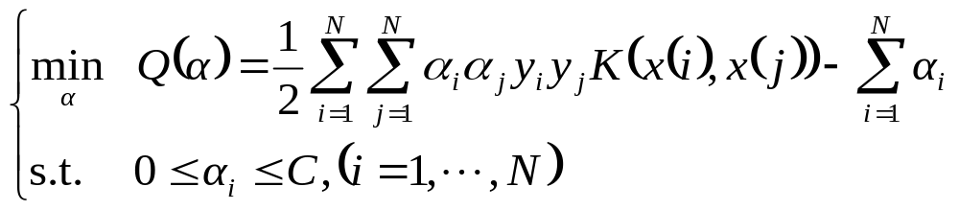
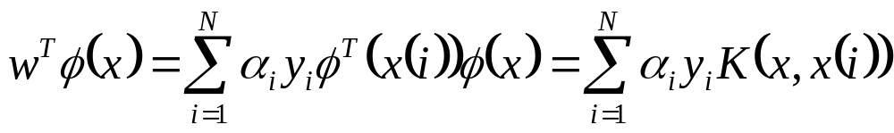
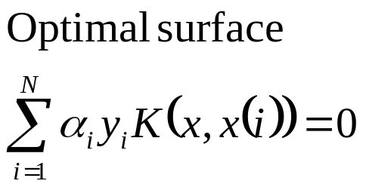
Non-linear SVM

Slide 31
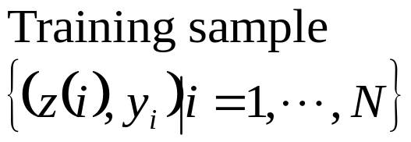
Non-linear SVM
Using kernel functions, one need not to know the nonlinear mapping!
Surprise!!!

Slide 32
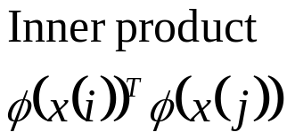

Non-linear SVM

Slide 33
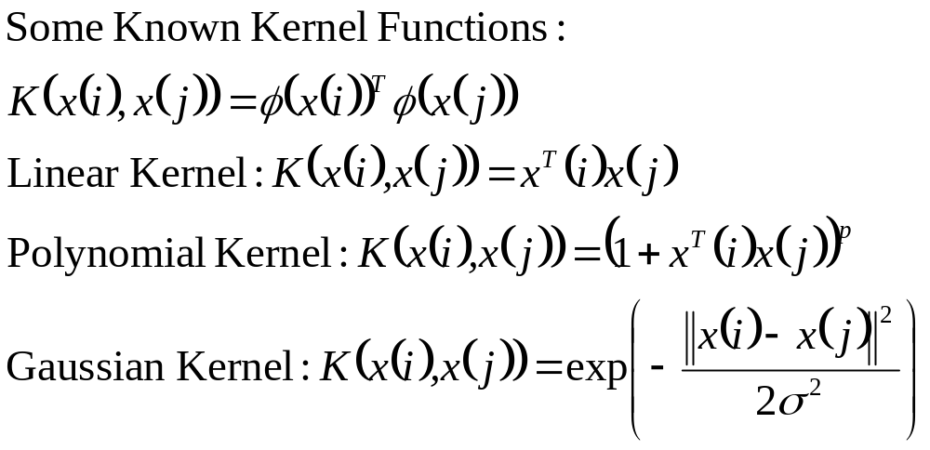
Some Kernel Functions

Slide 34
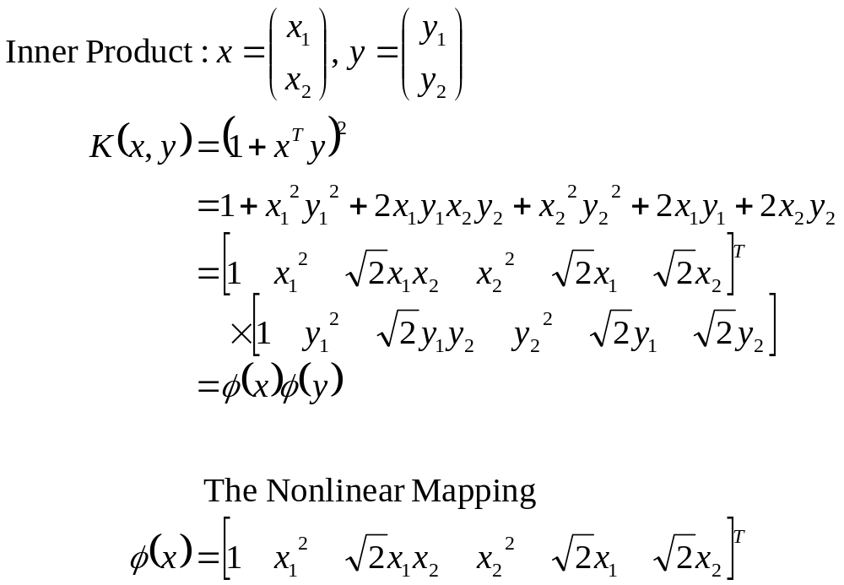
Example of Kernel Function

Slide 35
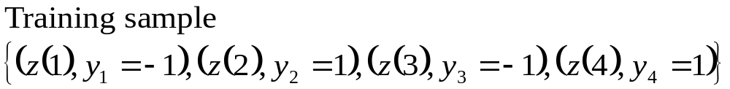
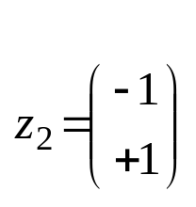
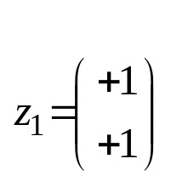

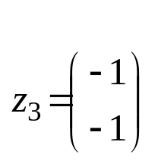
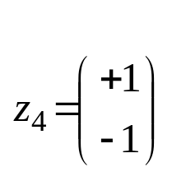
Example of Kernel Function

Slide 36
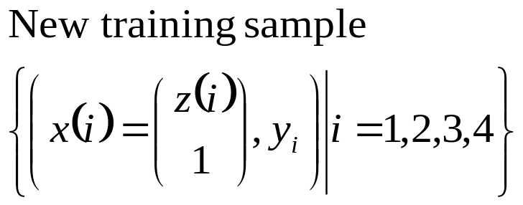
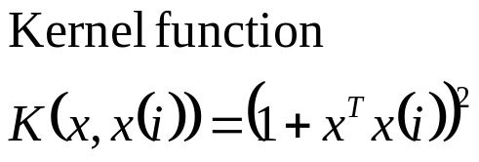
Example of Kernel Function

Slide 37
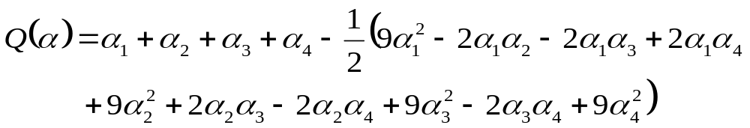
Example of Kernel Function

Slide 38
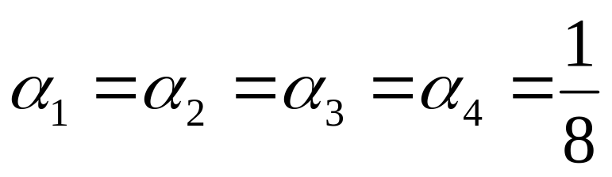
Example of Kernel Function

Slide 39

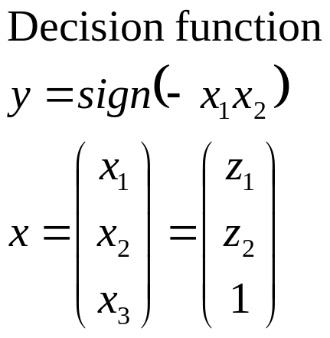
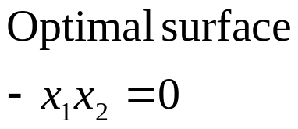
Example of Kernel Function

Slide 40
Training SVM
The solution of a very large quadratic programming (QP) optimization problem

Slide 41
SMO
Sequential Minimal Optimization

Slide 42
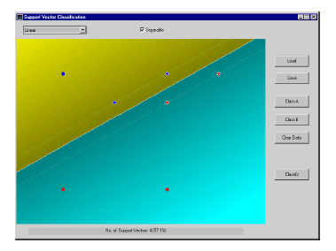
Experiments: Linear SVM

Slide 43
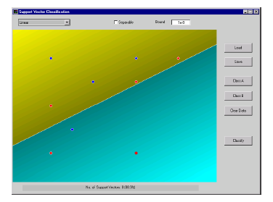
Experiments: Linear SVM with Soft Margin

Slide 44
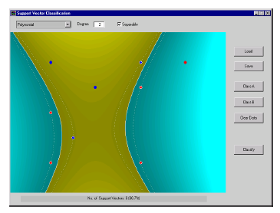
Experiments: Non-linear SVM

Slide 45
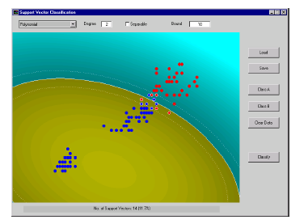
Experiments: Non-linear SVM with Soft Margin

Slide 46
LibSVM

Slide 47


